Slide 1
RepQuest Project Design
Dylan Hulon, Austin Jones, Benjamin Johnson, Jaylen Cook

Slide 2
We are RepQuest!! (Agenda)
We will be discussing the design architecture of RepQuest.
Or in other words, how the application will be designed.
We will also be discussing how the application will function.
We will be discussing and presenting subject matters about the,
Gamification
User Interface (or StoryBoard)
Block Diagram
Component Diagram
Entity-Relationship Diagram (ERD)
Storage Documentation
Message Documentation

Slide 3
Basic Description (refresher)
To begin, RepQuest will be an application that runs on Android that allows the user to create workout templates, upload workouts, and monitor their progress, history, statistics, and goals!
In addition to this, we plan to implement a gamification layer to the application. The goal of this is to help enhance the user’s overall experience of the application!

Slide 4



Gamification Layer
The gamification layer will enhance the user’s experience, and appeal to different groups of individuals.
Where the user, achieves goals, will earn experience points(EXP).
The user will then be able to unlock items after leveling up, and customize their avatar!

Slide 5
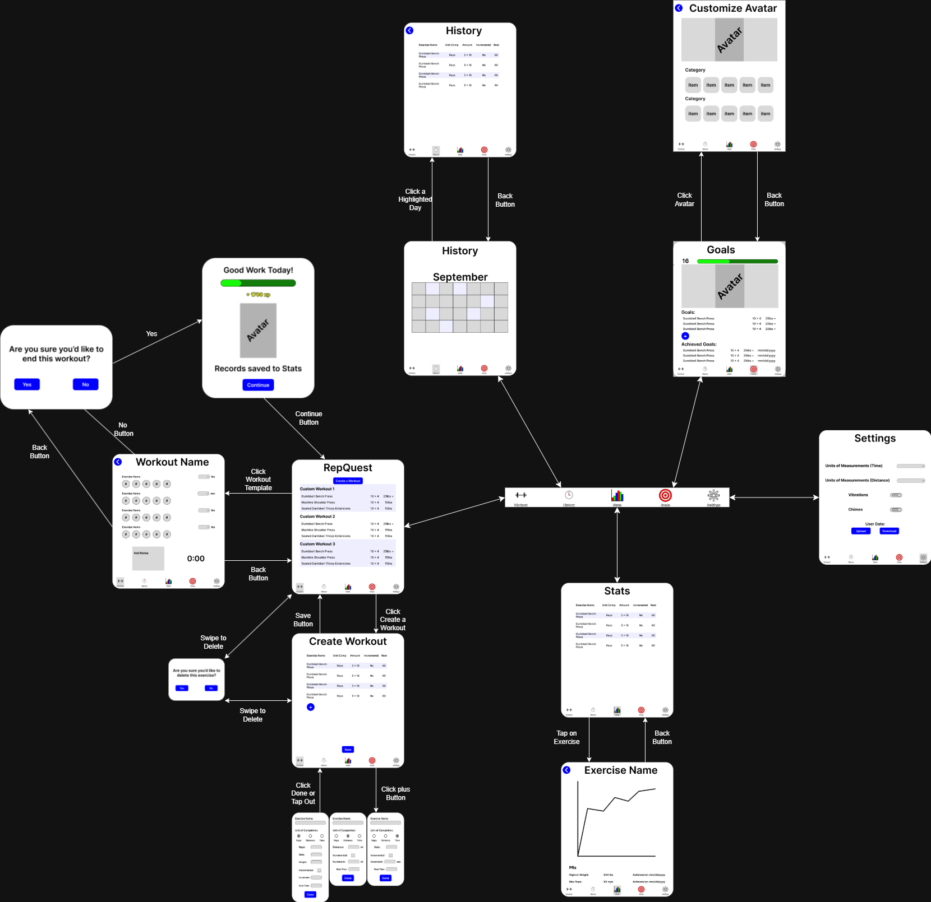
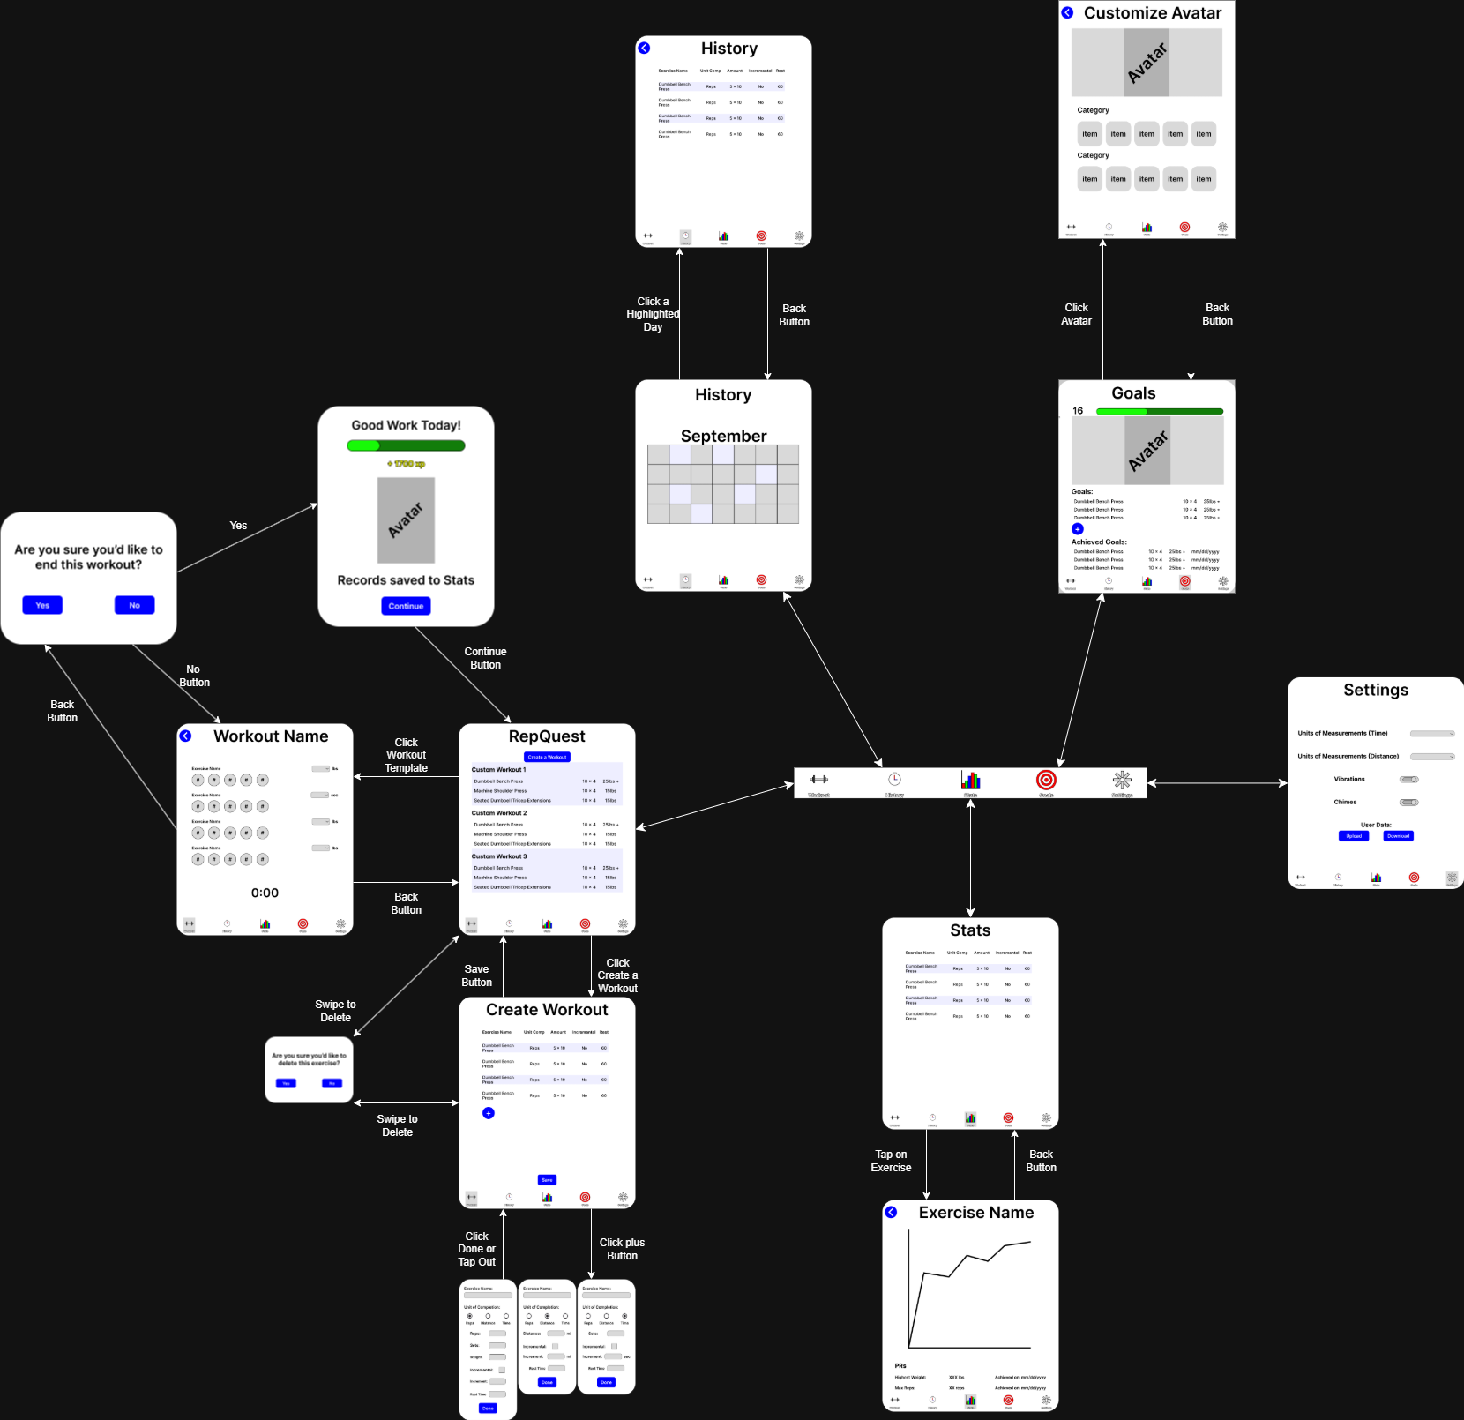
User Interface Storyboard

Slide 6
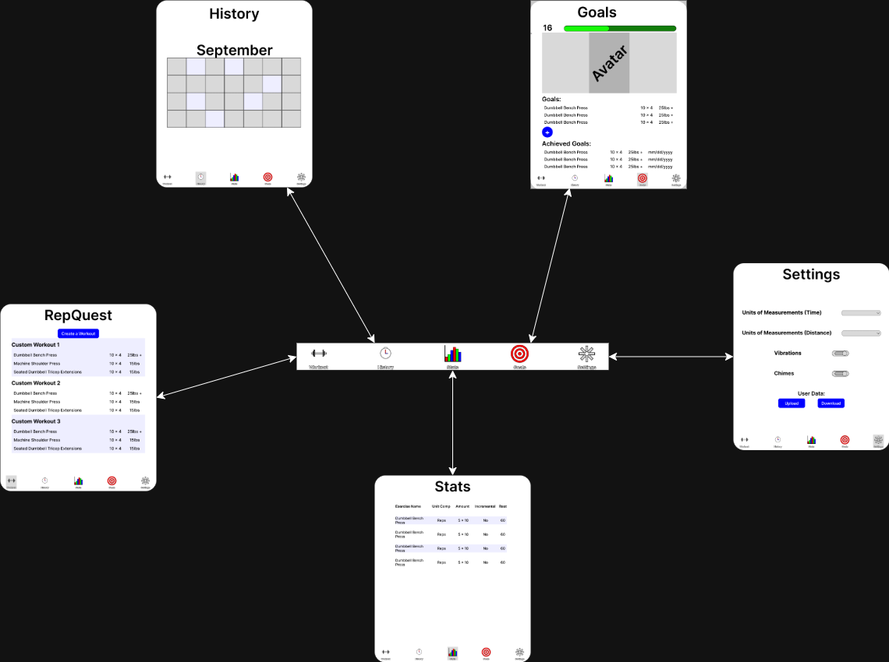
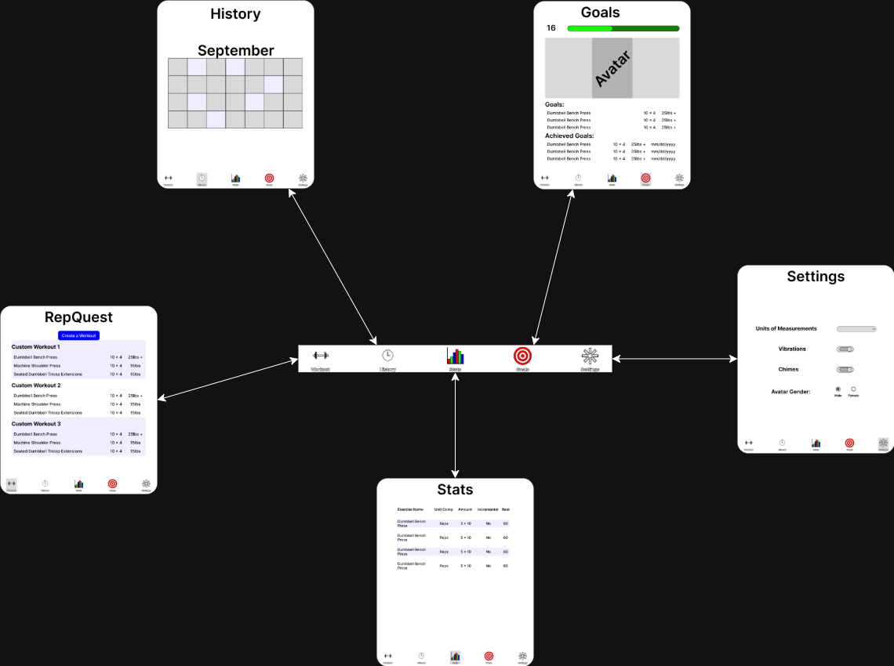

User Interface (Navbar)
Use the Navbar to switch between the “main” pages.

Slide 7
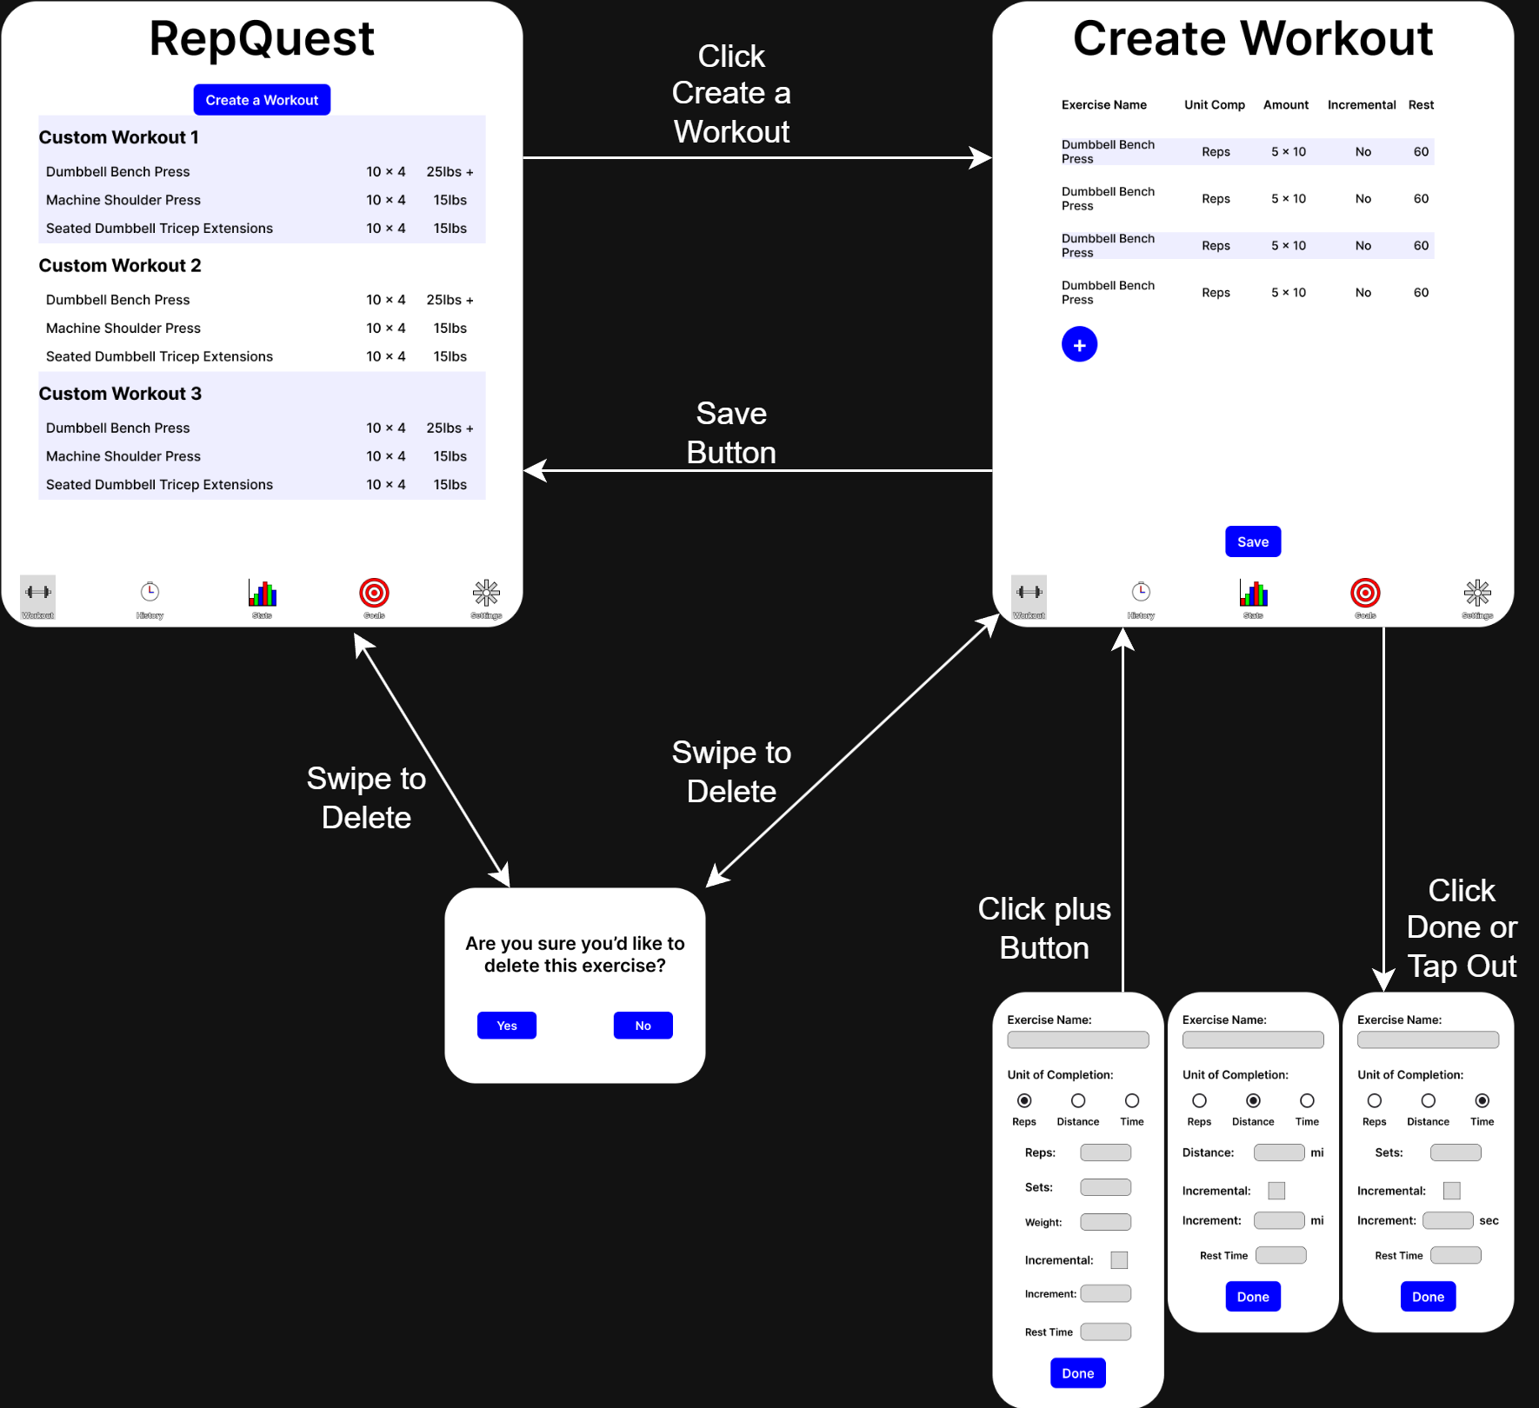
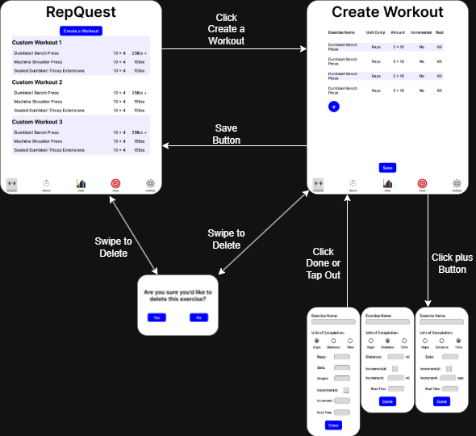
User Interface (Create Workout)
Click Create a Workout to get started
Swipe on an existing template to delete
Confirmation box will appear
Click the “+” button to add an exercise
Information will change depending on the exercise
Swipe to delete an exercise
Confirmation box will appear

Slide 8
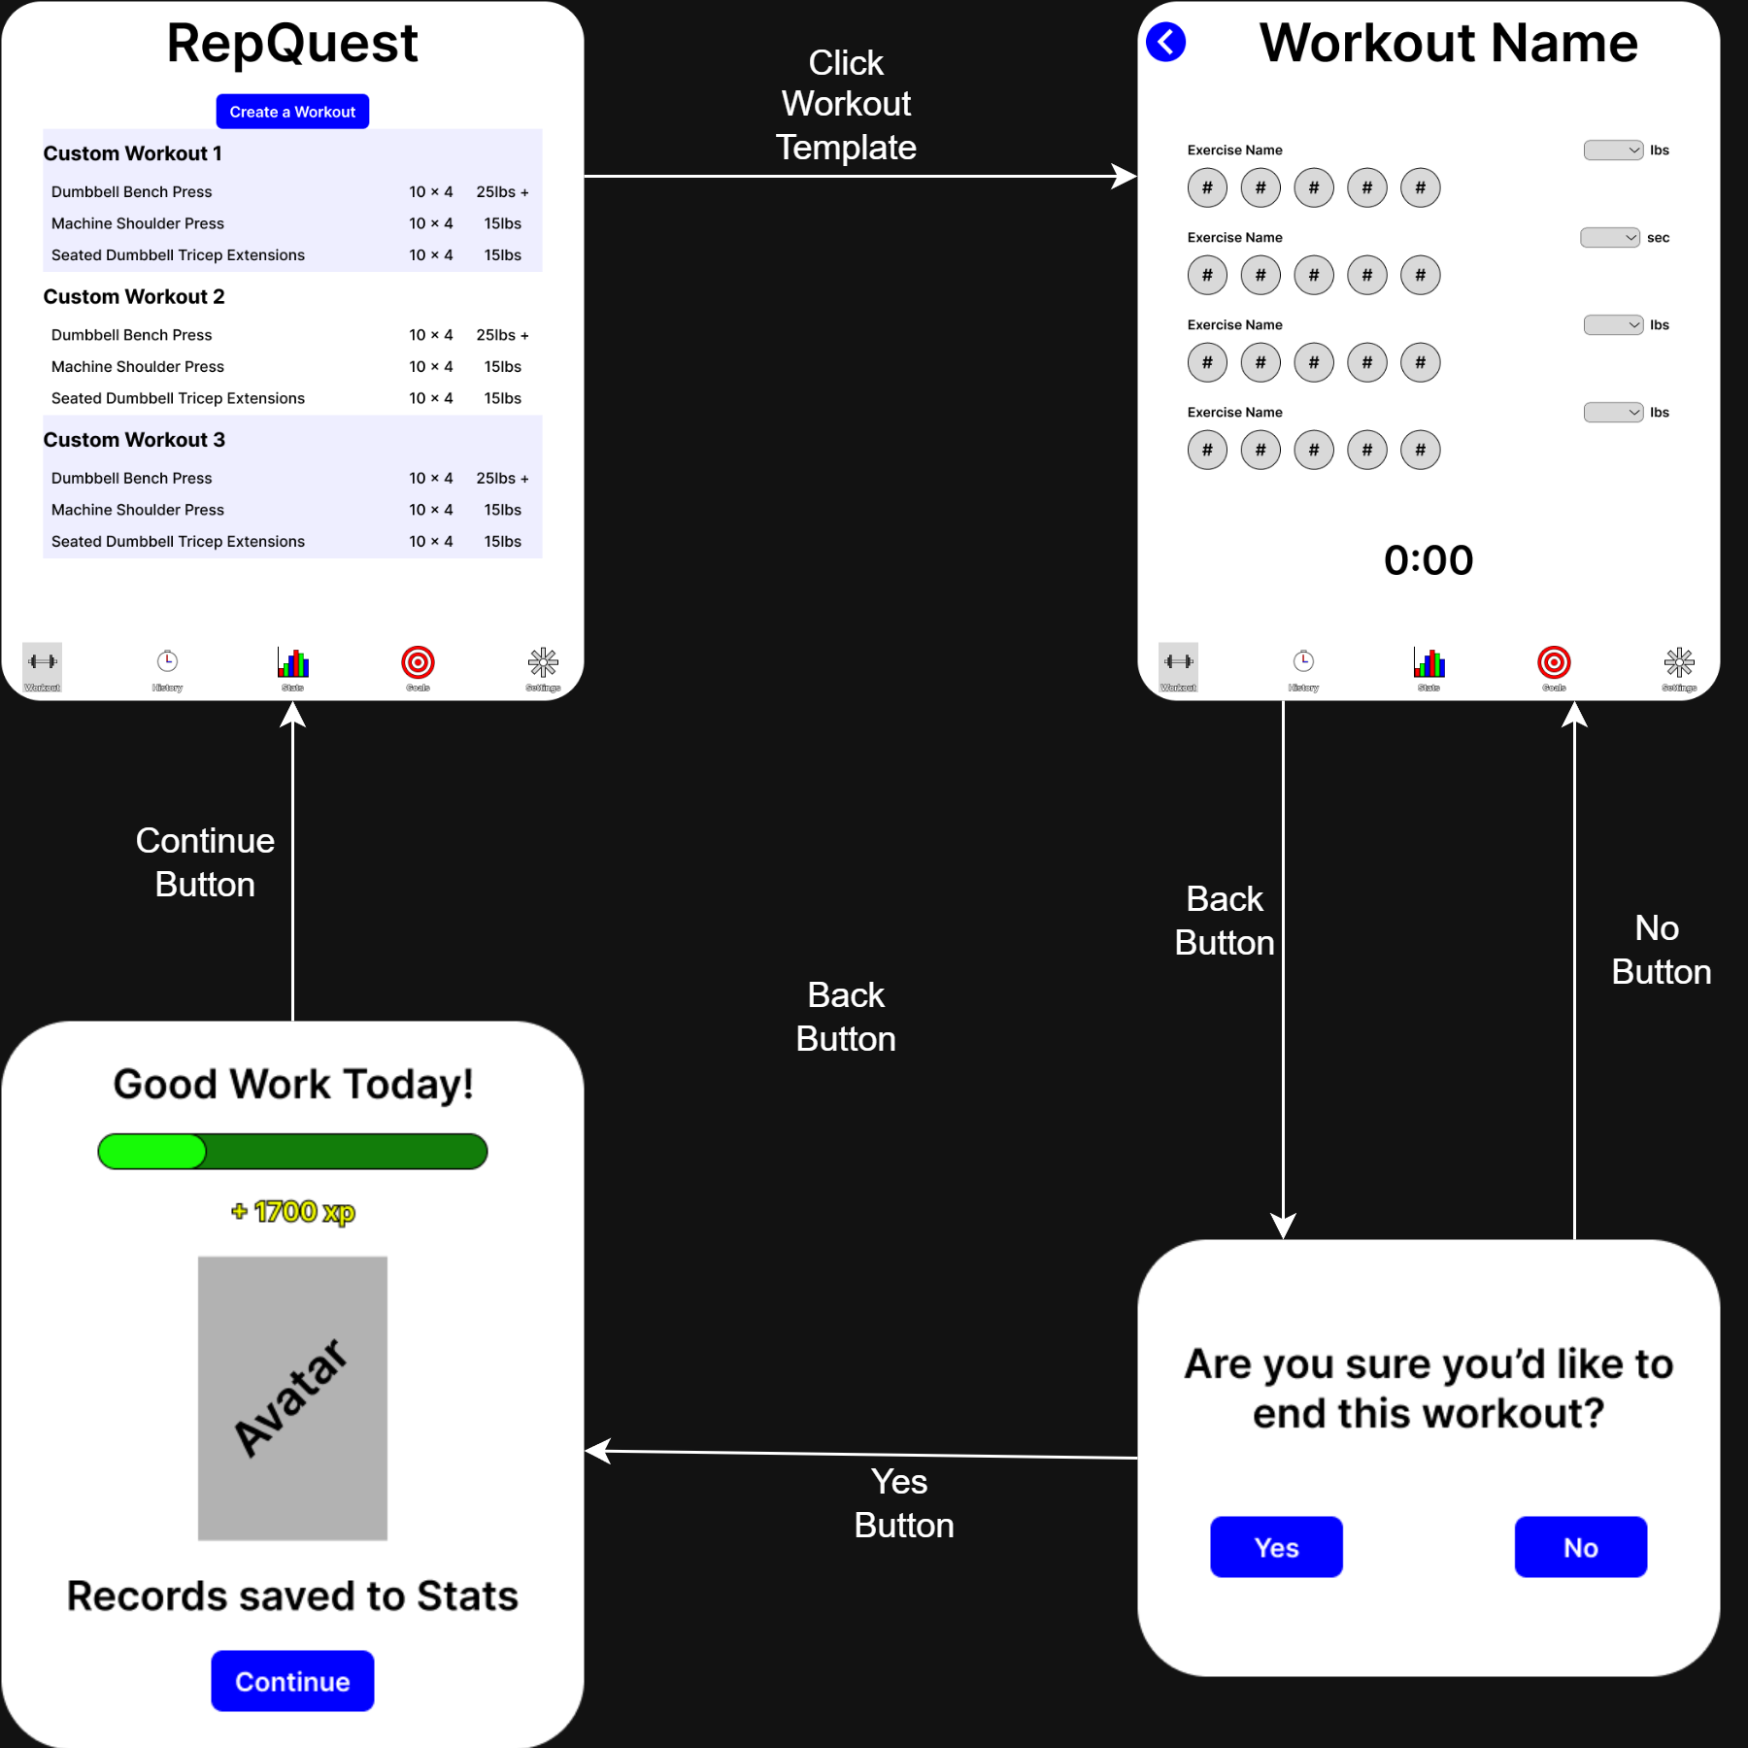


User Interface (Workout)
Click a template to start a Workout
Each Exercise has 1 completion bubble per set entered
Tap once to mark set complete, tap again to lower the number
Press the back button to quit
Confirmation box will appear
Confirming will send you to the experience screen

Slide 9
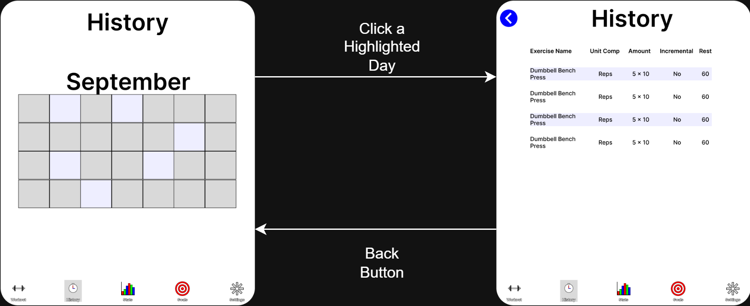
User Interface (History)
Click on a highlighted day to see the exercises and notes you have saved for that day

Slide 10
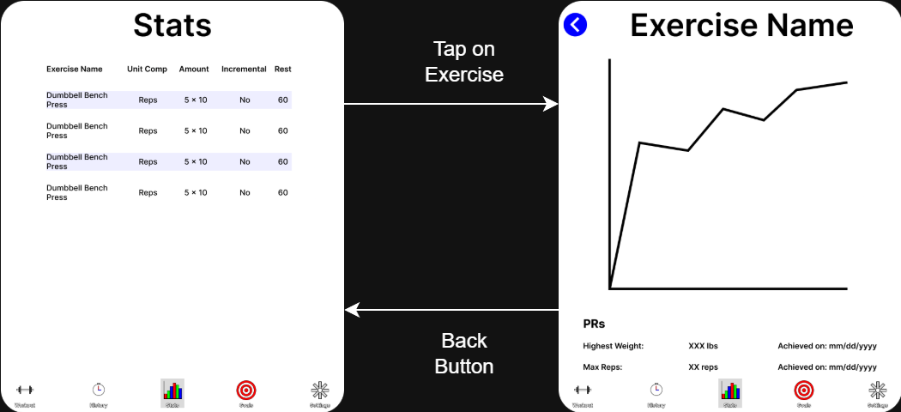
User Interface (Stats)
Click on an exercise to see how you’ve performed on an exercise over time

Slide 11
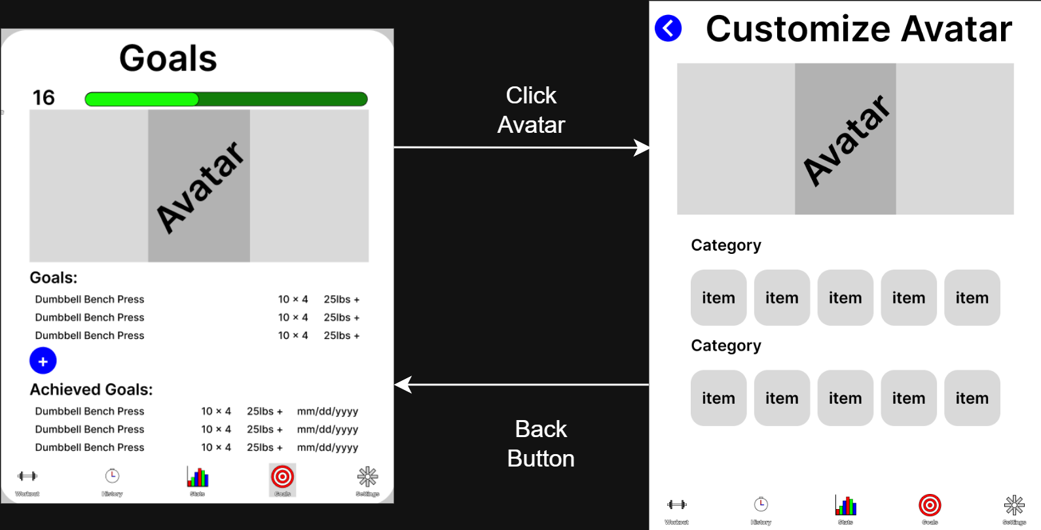
User Interface (Goals)
Here you can check and add goals you’ve made for each exercise
You can also change your avatar

Slide 12
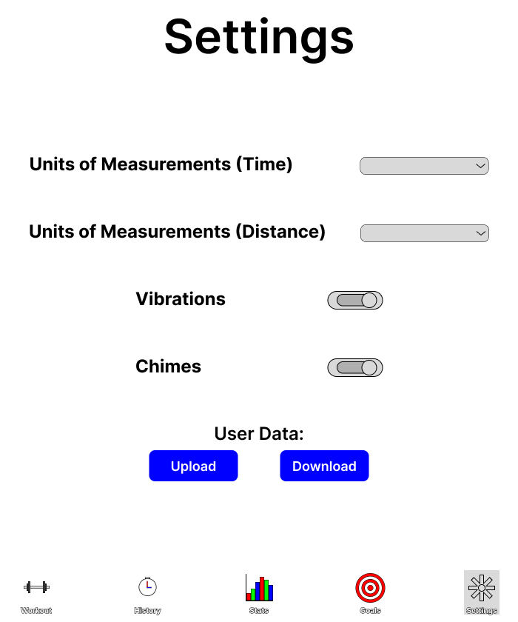
User Interface (Settings)
Change various settings
Unit of measurements
Vibrations
Chimes

Slide 13
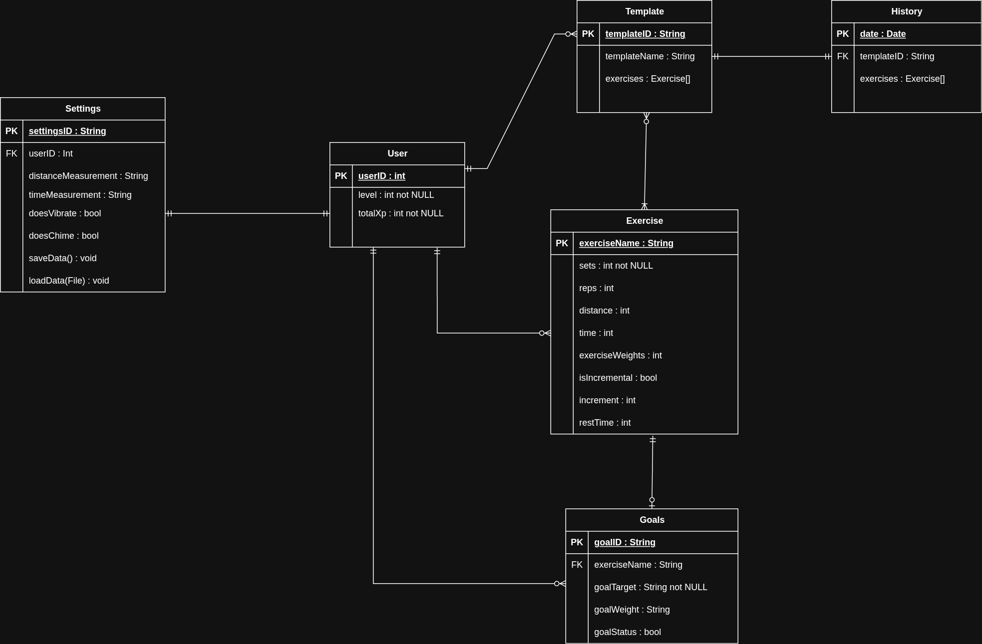
Entity-Relationship Diagram
Notes:
Here is the ERD.
You can see that the user has zero or more of both exercises and workouts, while each workout has to have at least one exercise.

Slide 14
Storage
RepQuest will be using Firebase Database and Firebase Server.
Firebase Database will store the data of the user.
Such as, templates, experience points, workouts, goals, history, and statistics.
Firebase Server will handle the authentication of the component layers.
Such as,
Syncing user data and the database.
Upload/download new templates/workouts, exp, goals, stats.
The user will also be given the option to permit upload/download over Wi-Fi only or allow upload/download using mobile data

Slide 15
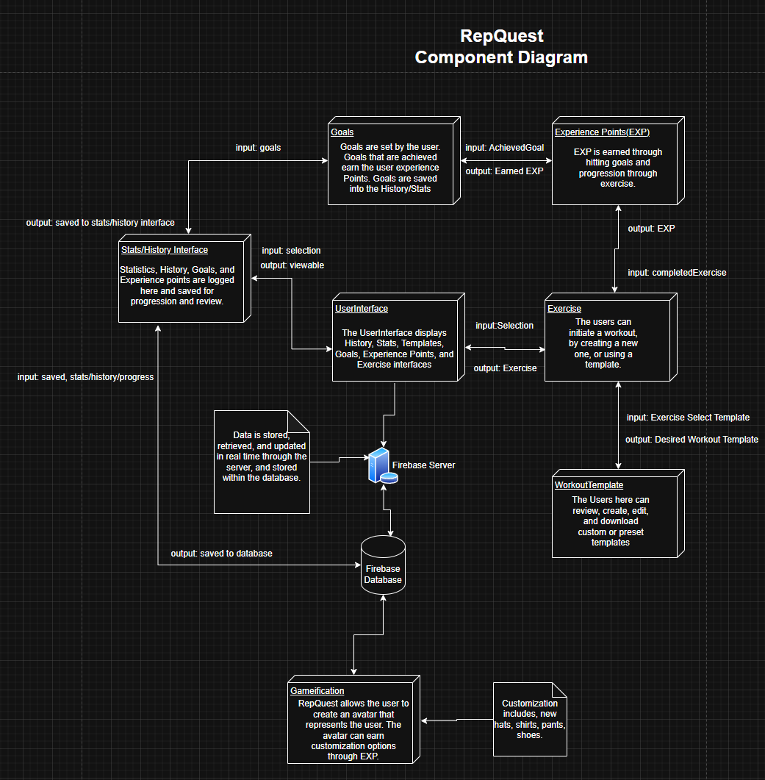
Component Diagram
This is a full view of the entire component diagram.
The component diagram shows the main components and how they function together within the application.

Slide 16
Component Diagram (2)
To go further into detail, if the user begins a workout, the user goes through the user interface to begin.
Once the workout is completed,
If there are any goals hit or experience points earned those are logged within the History/Statistics/Goal location of the user Interface.
The information is then uploaded to the database for storage, and can be retrieved later for viewing (history tab).
Or the user can save the workout and create their own template!
If they don’t like that workout later, it can be removed and or changed through the user interface.
Notes:
Specifically, if the user begins a workout, they will first have to interact with the user interface.
Once their workout is completed, if there are any goals hit or experience points earned, they will be logged within the corresponding location in the UI for history, statistics, or goals.
This information is then uploaded to the database so it can be stored and later retrieved and viewed on the history tab.
The user can also save their workout as a template, which can later be removed or changed through the user interface.

Slide 17
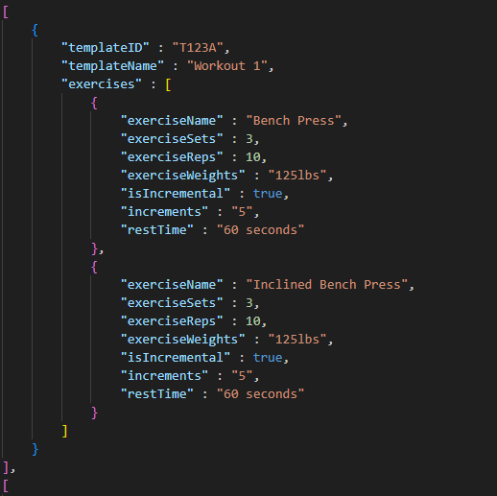
Message Documentation
(Workout Templates)

Slide 18
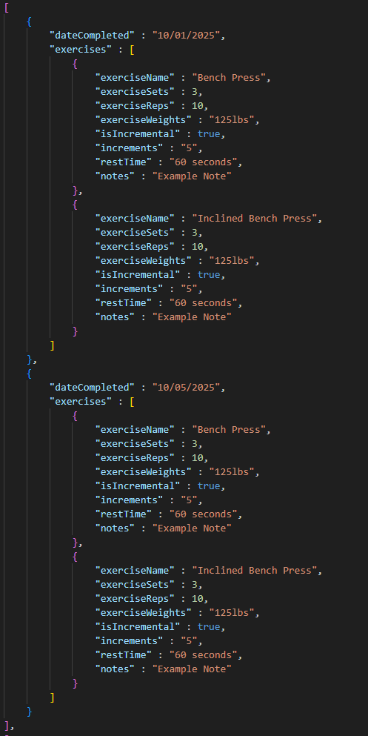
Message Documentation
(History)

Slide 19
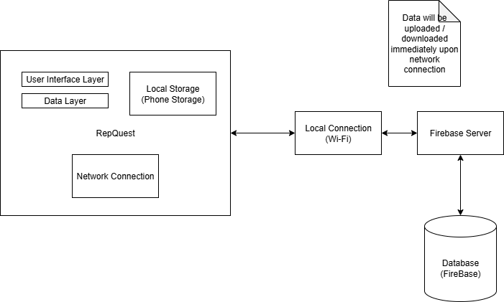
Block Diagram
The block diagram describes the three main component of the application.
The Firebase Server & Database,
The local/network connection layer,
The User Interface layer
Firebase Server & Database
Firebase database that retrieves and stores data.
Firebase server that handles the requests to retrieve and store data from the database.
Data Syncing
Data can be synced over WiFi or a service provider internet (cell phone service)
Data is then uploaded and downloaded periodically.
Notes:
The block diagram describes the three main component of the application, the Firebase Server & Database, the local/network connection layer, and the User Interface layer.
The firebase database retrieves and stores data.
The firebase server handles the requests to retrieve and store data from the database.
Data can be synced over a WiFi connection or service provider internet, like cellular data.
Data will then be uploaded and downloaded periodically.
All data will be saved once daily.
Certain actions will cause an immediate save to happen, including but not limited to:
Creating a Workout Template
Completing a Workout
Confirming a change in Settings

Slide 20
Summary
To begin our closeout, the goal of RepQuest is intended to help user’s enjoy working out with the help of a user-friendly interface that includes an avatar!
RepQuest allows for data to be uploaded and downloaded periodically with the use of Firebase Database & Firebase Server.
Workouts, templates, goals and statistics are stored and synced in real time.
Gamification rewards users with EXP and avatar updates to encourage progress.

Slide 21
Thank you all for your time!
-RepQuest

